Slide 1
Initial value formulation of displacement vector (1)

Slide 2
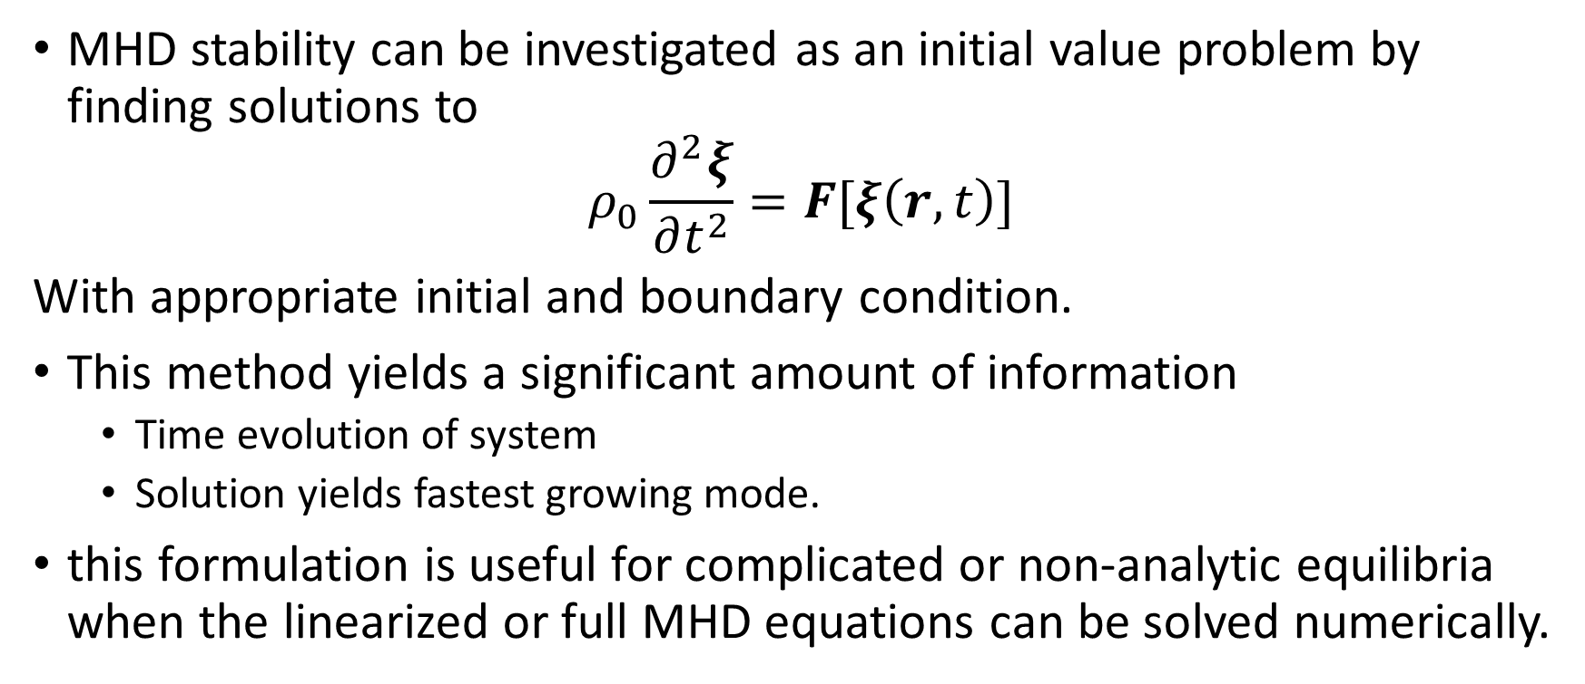
Initial value formulation
MHD stability can be investigated as an initial value problem by finding solutions to
$$ρ_{0}\frac{∂^{2}ξ}{∂t^{2}}=F[ξ\left(r,t\right)]$$
With appropriate initial and boundary condition.
This method yields a significant amount of information
Time evolution of system
Solution yields fastest growing mode.
this formulation is useful for complicated or non-analytic equilibria when the linearized or full MHD equations can be solved numerically.

Slide 3

With:
$$F\left(ξ\right)=∇\left(ξ∙∇ρ_{0}+ρ∇∙ξ\right)$$
$$+\frac{1}{μ_{0}}\left(∇×B_{0}\right)×\left[∇×\left(ξ×B_{0}\right)\right]$$
$$+\frac{1}{μ_{0}}\{\left[∇×∇×\left(ξ×B_{0}\right)\right]×B_{0}\}$$

Slide 4
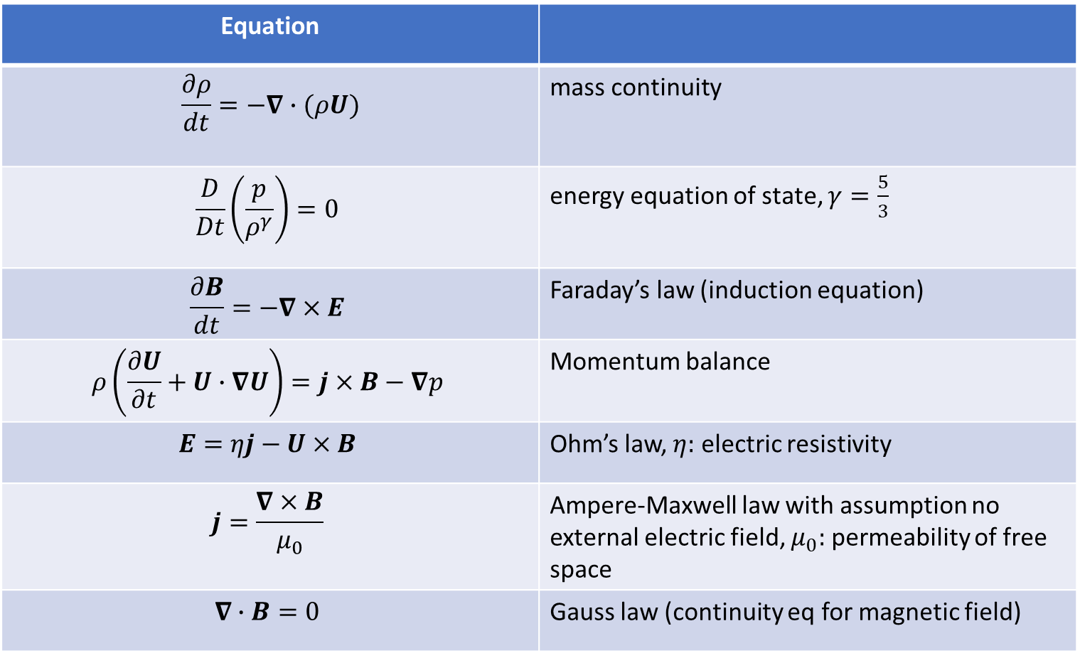
MHD Equation
Equation
$$\frac{∂ρ}{dt}=−∇∙(ρU)$$ | mass continuity
$$\frac{D}{Dt}\left(\frac{p}{ρ^{γ}}\right)=0$$ | energy equation of state, $γ=\frac{5}{3}$
$$\frac{∂B}{dt}=−∇×E$$ | Faraday’s law (induction equation)
$$ρ\left(\frac{∂U}{∂t}+U∙∇U\right)=j×B−∇p$$ | Momentum balance
$$E=ηj−U×B$$ | Ohm’s law, $η:$ electric resistivity
$$j=\frac{∇×B}{μ_{0}}$$ | Ampere-Maxwell law with assumption no external electric field, $μ_{0}:$ permeability of free space
$$∇∙B=0$$ | Gauss law (continuity eq for magnetic field)

Slide 5
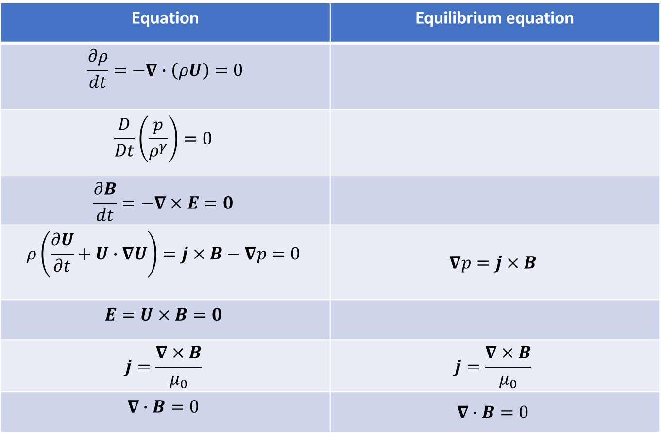

Static MHD Equilibrium $(U=0)$
Equation | Equilibrium equation
$$\frac{∂ρ}{dt}=−∇∙\left(ρU\right)=0$$
$$\frac{D}{Dt}\left(\frac{p}{ρ^{γ}}\right)=0$$
$$\frac{∂B}{dt}=−∇×E=0$$
$$ρ\left(\frac{∂U}{∂t}+U∙∇U\right)=j×B−∇p=0$$ | $$∇p=j×B$$
$$E=U×B=0$$
$$j=\frac{∇×B}{μ_{0}}$$ | $$j=\frac{∇×B}{μ_{0}}$$
$$∇∙B=0$$ | $$∇∙B=0$$

Slide 6
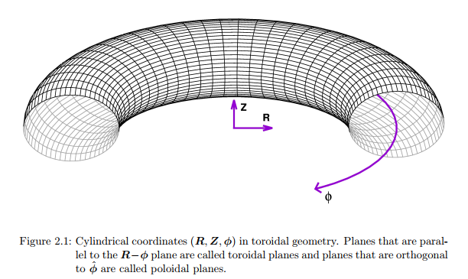
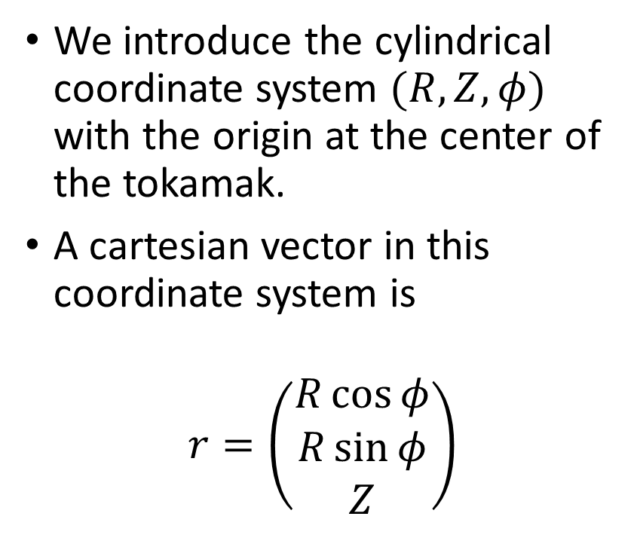
Coordinate system
We introduce the cylindrical coordinate system $(R,Z,φ)$ with the origin at the center of the tokamak.
A cartesian vector in this coordinate system is
$$r=\left(\begin{matrix}R\cos{φ} \\ R\sin{φ} \\ Z\end{matrix}\right)$$

Slide 7

Poloidal and toroidal terms
$$B=B_{pol}+B_{tor}$$
With
$$B_{pol}=B_{R} e_{R}+B_{Z} e_{Z}$$
$$B_{tor}=B_{φ} e_{φ}$$
$e_{R},e_{φ},e_{z}$ standard basis.
Or we could write $B$ as
$$B=\left(\begin{matrix}B_{R} \\ B_{φ} \\ B_{z}\end{matrix}\right)$$

Slide 8
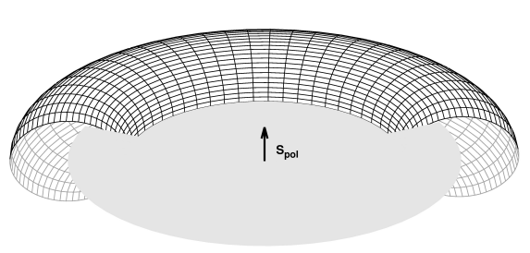
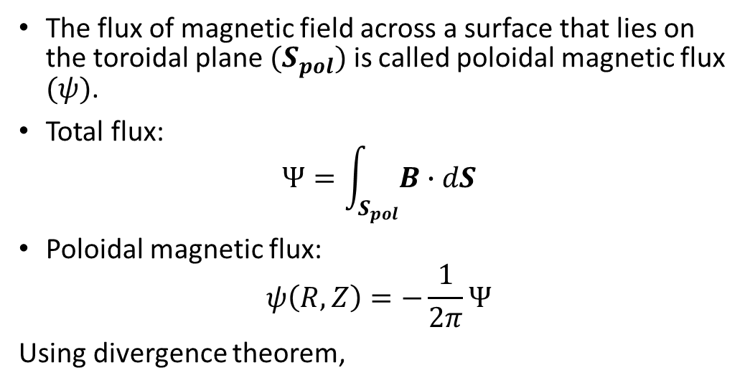
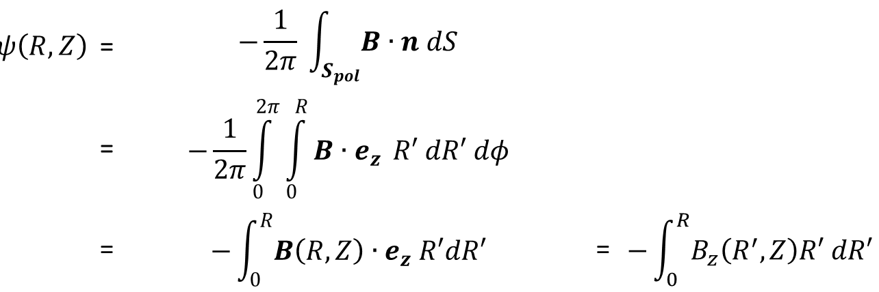
Magnetic Flux
The flux of magnetic field across a surface that lies on the toroidal plane $(S_{pol})$ is called poloidal magnetic flux $(ψ)$.
Total flux:
$$Ψ=\int_{S_{pol}}^{ }{B∙dS}$$
Poloidal magnetic flux:
$$ψ\left(R,Z\right)=−\frac{1}{2π}Ψ$$
Using divergence theorem,
$$ψ\left(R,Z\right)$$ | = | $$−\frac{1}{2π} \int_{S_{pol}}^{ }{B∙n dS}$$
 | = | $$−\frac{1}{2π}\int_{0}^{2π}{\int_{0}^{R}{B∙e_{z}} R′ dR′ dφ}$$
 | = | $$−\int_{0}^{R}{B\left(R,Z\right)}∙e_{z} R′dR′$$ | = | $$−\int_{0}^{R}{B_{z}\left(R^{′},Z\right)R′ dR′}$$

Slide 9
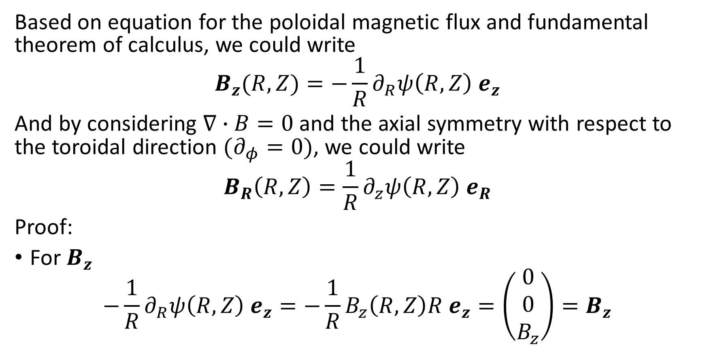
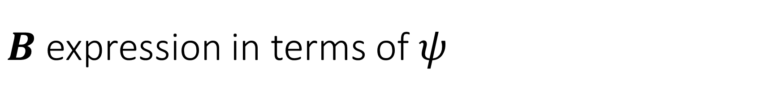
$B$ expression in terms of $ψ$
Based on equation for the poloidal magnetic flux and fundamental theorem of calculus, we could write
$$B_{z}(R,Z)=−\frac{1}{R}∂_{R}ψ\left(R,Z\right) e_{z}$$
And by considering $∇∙B=0$ and the axial symmetry with respect to the toroidal direction $(∂_{φ}=0)$, we could write
$$B_{R}\left(R,Z\right)=\frac{1}{R}∂_{z}ψ\left(R,Z\right) e_{R}$$
Proof:
For $B_{z}$
$$−\frac{1}{R}∂_{R}ψ\left(R,Z\right) e_{z}=−\frac{1}{R}B_{z}\left(R,Z\right)R e_{z}=\left(\begin{matrix}0 \\ 0 \\ B_{z}\end{matrix}\right)=B_{z}$$

Slide 10
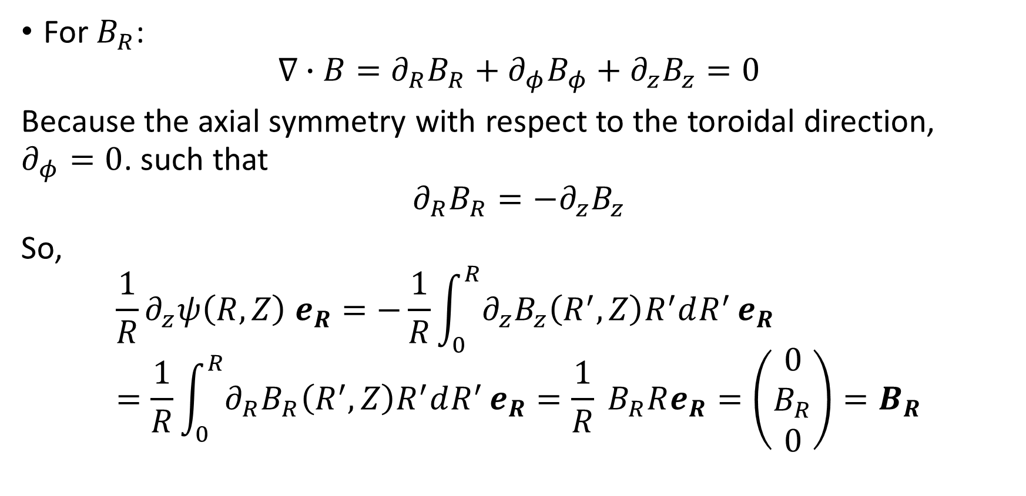
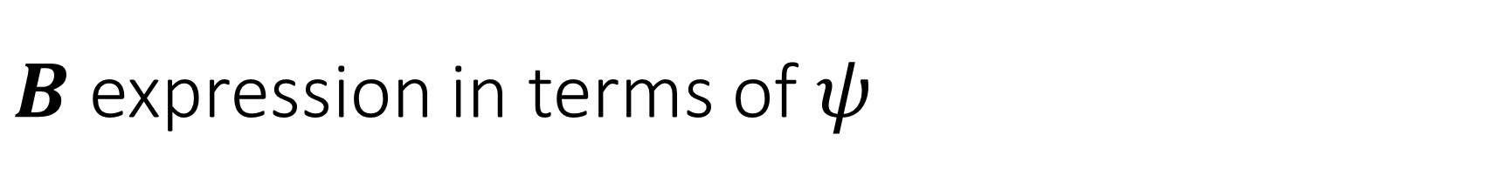
$B$ expression in terms of $ψ$
For $B_{R}$:
$$∇∙B=∂_{R}B_{R}+∂_{φ}B_{φ}+∂_{z}B_{z}=0$$
Because the axial symmetry with respect to the toroidal direction, $∂_{φ}=0$. such that
$$∂_{R}B_{R}=−∂_{z}B_{z}$$
So,
$$\frac{1}{R}∂_{z}ψ\left(R,Z\right) e_{R}=−\frac{1}{R}\int_{0}^{R}{∂_{z}B_{z}\left(R^{′},Z\right)R^{′}dR^{′}}e_{R}=\frac{1}{R}\int_{0}^{R}{∂_{R}B_{R}\left(R^{′},Z\right)R^{′}dR^{′}}e_{R}=\frac{1}{R} B_{R}Re_{R}=\left(\begin{matrix}0 \\ B_{R} \\ 0\end{matrix}\right)=B_{R}$$

Slide 11

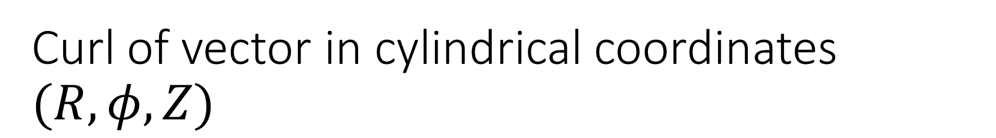
Curl of vector in cylindrical coordinates $(R,φ,Z)$
$$∇×A=\frac{1}{R}\left|\begin{matrix}e_{R} & {Re}_{φ} & e_{z} \\ ∂_{R} & ∂_{φ} & ∂_{z} \\ A_{R} & RA_{φ} & A_{z}\end{matrix}\right|$$
$$∇×A=\frac{1}{R}\left[\left(−∂_{φ}A_{z}+∂_{z}RA_{φ}\right)e_{R}+R\left(−∂_{z}A_{R}+∂_{R}A_{z}\right) e_{φ}+\left(−∂_{R}RA_{φ}+∂_{φ}A_{R}\right)e_{z}\right]$$

Slide 12
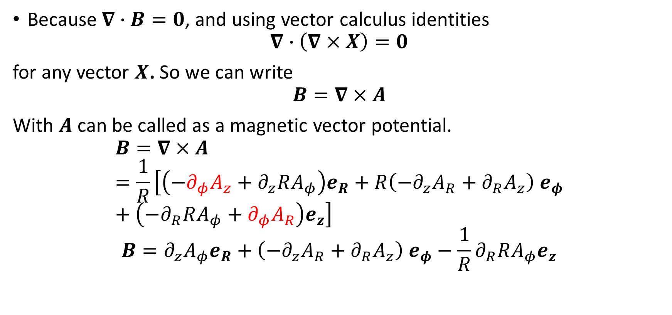
Magnetic Vector Potential
Because $∇∙B=0$, and using vector calculus identities
$$∇∙\left(∇×X\right)=0$$
for any vector $X$. So we can write
$$B=∇×A$$
With $A$ can be called as a magnetic vector potential.
$$B=∇×A=\frac{1}{R}\left[\left(−∂_{φ}A_{z}+∂_{z}RA_{φ}\right)e_{R}+R\left(−∂_{z}A_{R}+∂_{R}A_{z}\right) e_{φ}+\left(−∂_{R}RA_{φ}+∂_{φ}A_{R}\right)e_{z}\right]$$
$$B=∂_{z}A_{φ}e_{R}+\left(−∂_{z}A_{R}+∂_{R}A_{z}\right) e_{φ}−\frac{1}{R}∂_{R}RA_{φ}e_{z}$$

Slide 13


Relationship between $ψ$ and $A$
$B_{R}=\frac{1}{R}∂_{z}ψ=∂_{z}A_{φ}$
$B_{z}=−\frac{1}{R}∂_{R}ψ=−\frac{1}{R}∂_{R}RA_{φ}$
So that,
$$ψ=RA_{φ}$$

Slide 14
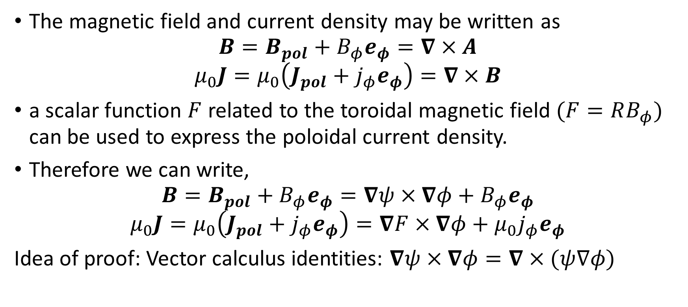
A compact way to describe magnetic field for toroidal geometry
The magnetic field and current density may be written as
$$B=B_{pol}+B_{φ}e_{φ}=∇×A$$
$$μ_{0}J=μ_{0}\left(J_{pol}+j_{φ}e_{φ}\right)=∇×B$$
a scalar function $F$ related to the toroidal magnetic field $(F=RB_{φ})$ can be used to express the poloidal current density.
Therefore we can write,
$$B=B_{pol}+B_{φ}e_{φ}=∇ψ×∇φ+B_{φ}e_{φ}$$
$$μ_{0}J=μ_{0}\left(J_{pol}+j_{φ}e_{φ}\right)=∇F×∇φ+{μ_{0}j}_{φ}e_{φ}$$
Idea of proof: Vector calculus identities: $∇ψ×∇φ=∇×(ψ∇φ)$

Slide 15
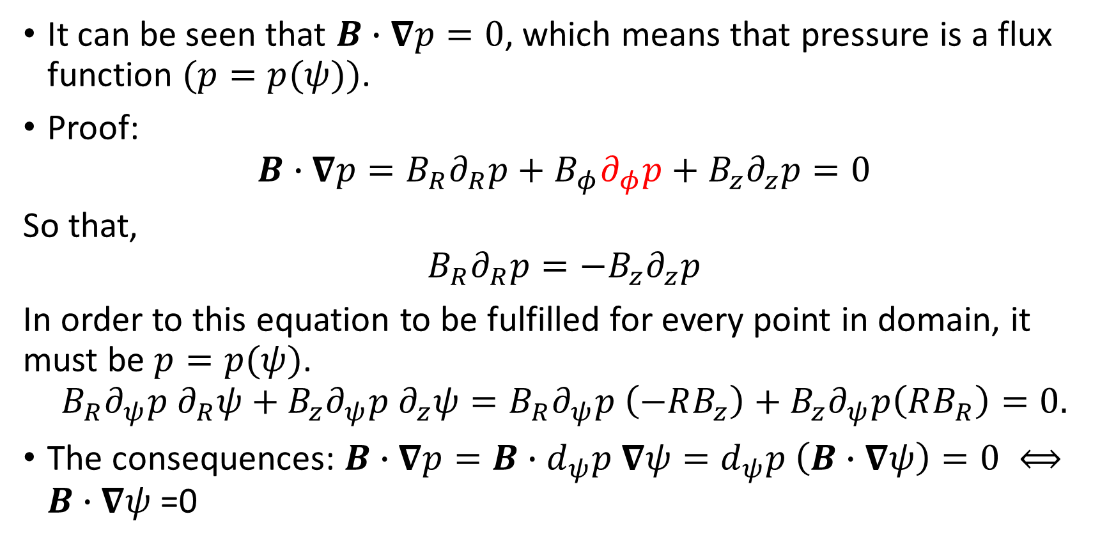
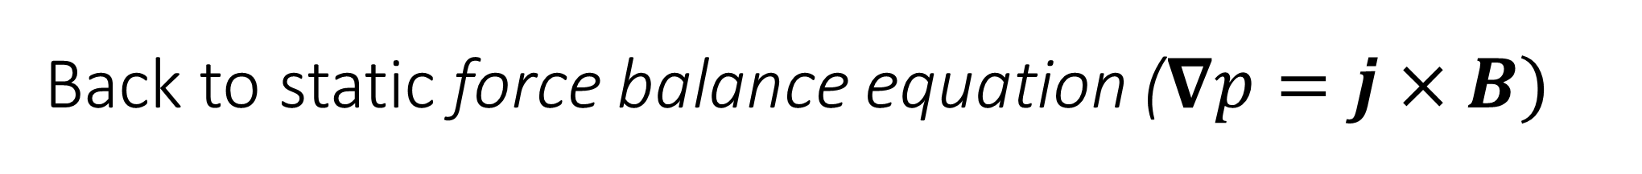
Back to static force balance equation ($∇p=j×B)$
It can be seen that $B∙∇p=0$, which means that pressure is a flux function $(p=p(ψ))$.
Proof:
$$B∙∇p=B_{R}∂_{R}p+B_{φ}∂_{φ}p+B_{z}∂_{z}p=0$$
So that,
$$B_{R}∂_{R}p=−B_{z}∂_{z}p$$
In order to this equation to be fulfilled for every point in domain, it must be $p=p(ψ)$.
$$B_{R}∂_{ψ}p ∂_{R}ψ+B_{z}∂_{ψ}p ∂_{z}ψ=B_{R}∂_{ψ}p \left(−RB_{z}\right)+B_{z}∂_{ψ}p\left(RB_{R}\right)=0.$$
The consequences: $B∙∇p=B∙d_{ψ}p ∇ψ=d_{ψ}p \left(B∙∇ψ\right)=0 ⟺B∙∇ψ$ =0

Slide 16
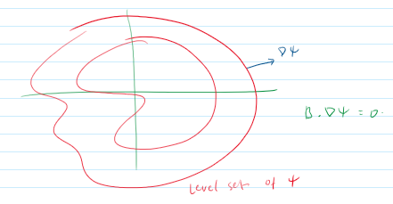

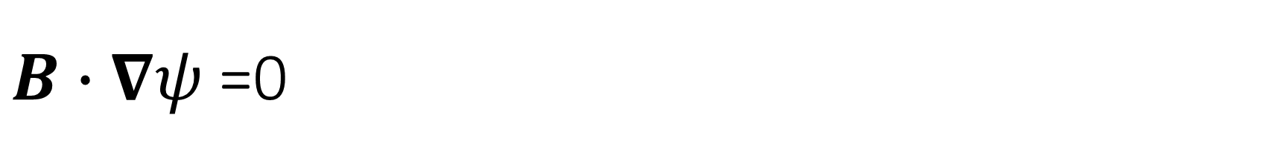
$B∙∇ψ$ =0
Magnetic field lines lie on surfaces of constant $ψ$.

Slide 17
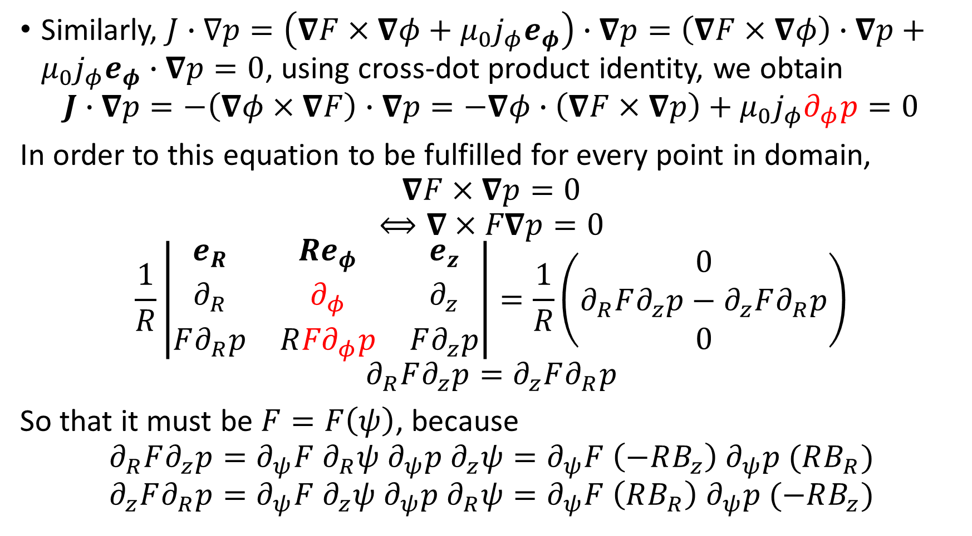
Poloidal current density (1)
Similarly, $J∙∇p=\left(∇F×∇φ+{μ_{0}j}_{φ}e_{φ}\right)∙∇p=\left(∇F×∇φ\right)∙∇p+{μ_{0}j}_{φ}e_{φ}∙∇p=0$, using cross-dot product identity, we obtain
$$J∙∇p=−\left(∇φ×∇F\right)∙∇p=−∇φ∙\left(∇F×∇p\right)+μ_{0}j_{φ}∂_{φ}p=0$$
In order to this equation to be fulfilled for every point in domain,
$$∇F×∇p=0$$
$$⟺∇×F∇p=0$$
$$\frac{1}{R}\left|\begin{matrix}e_{R} & {Re}_{φ} & e_{z} \\ ∂_{R} & ∂_{φ} & ∂_{z} \\ F∂_{R}p & R{F∂}_{φ}p & F∂_{z}p\end{matrix}\right|=\frac{1}{R}\left(\begin{matrix}0 \\ ∂_{R}F∂_{z}p−∂_{z}F∂_{R}p \\ 0\end{matrix}\right)$$
$$∂_{R}F∂_{z}p=∂_{z}F∂_{R}p$$
So that it must be $F=F\left(ψ\right)$, because
$$∂_{R}F∂_{z}p=∂_{ψ}F ∂_{R}ψ ∂_{ψ}p ∂_{z}ψ=∂_{ψ}F \left(−RB_{z}\right) ∂_{ψ}p (RB_{R})$$
$$∂_{z}F∂_{R}p=∂_{ψ}F ∂_{z}ψ ∂_{ψ}p ∂_{R}ψ=∂_{ψ}F \left(RB_{R}\right) ∂_{ψ}p (−RB_{z})$$

Slide 18
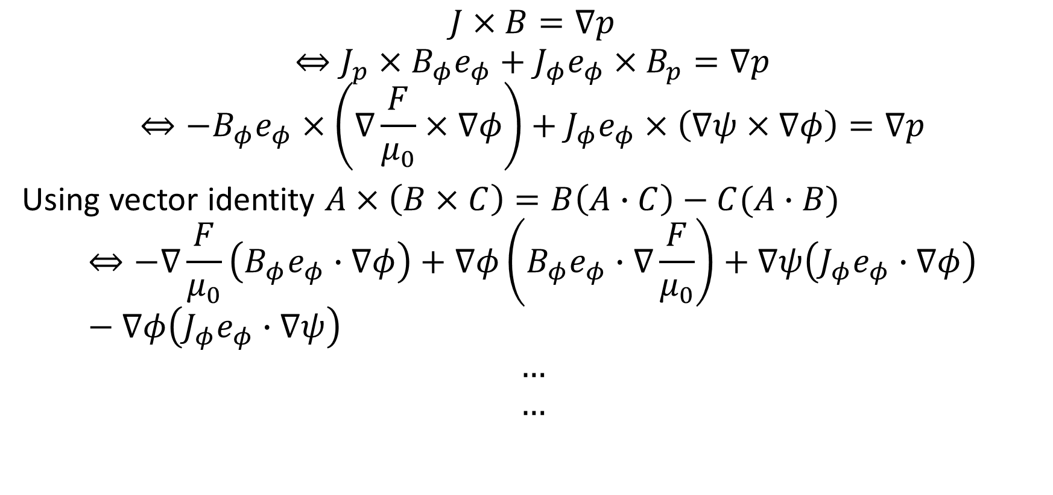

Back to static force balance equation ($∇p=j×B)$
$$J×B=∇p$$
$$⇔J_{p}×B_{φ}e_{φ}+J_{φ}e_{φ}×B_{p}=∇p$$
$$⇔−B_{φ}e_{φ}×\left(∇\frac{F}{μ_{0}}×∇φ\right)+J_{φ}e_{φ}×\left(∇ψ×∇φ\right)=∇p$$
Using vector identity $A×\left(B×C\right)=B\left(A∙C\right)−C(A∙B)$
$$⇔−∇\frac{F}{μ_{0}}\left(B_{φ}e_{φ}∙∇φ\right)+∇φ\left(B_{φ}e_{φ}∙∇\frac{F}{μ_{0}}\right)+∇ψ\left(J_{φ}e_{φ}∙∇φ\right)−∇φ\left(J_{φ}e_{φ}∙∇ψ\right)$$
$$…$$
$$…$$

Slide 19
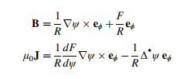

Grad-shafranov equation
$$μ_{0}R^{2}\frac{dp}{dψ}+F\frac{dF}{dψ}+Δ^{∗}ψ=0$$
With
$$Δ^{∗}ψ=R^{2}∇∙\left(\frac{∇ψ}{R^{2}}\right)=R^{2}∂_{R}\left(\frac{1}{R^{2}}∂_{R}ψ\right)+∂_{φ}^{2}ψ+∂_{z}^{2}ψ$$

